Slide 1
A Simple walking speed detector
Presenter: Ye Li
April 14th 2014

Slide 2
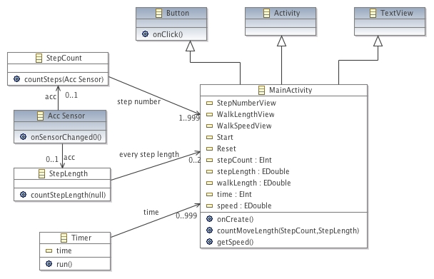
Meta-model

Slide 3
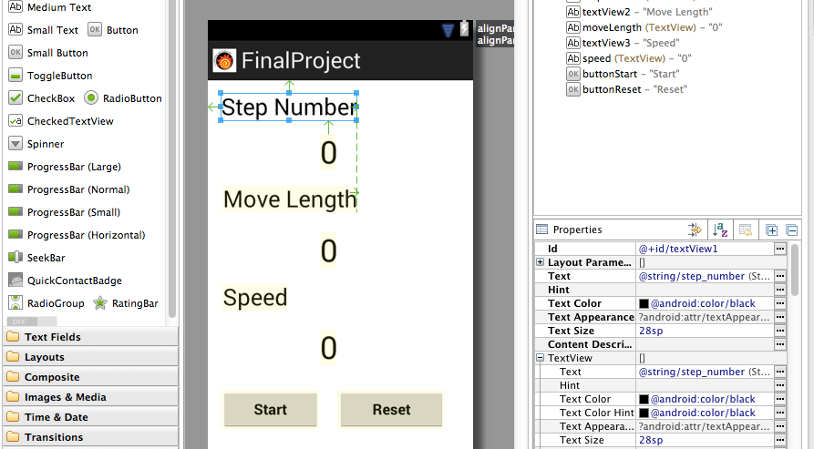
Android & MDE

Slide 4
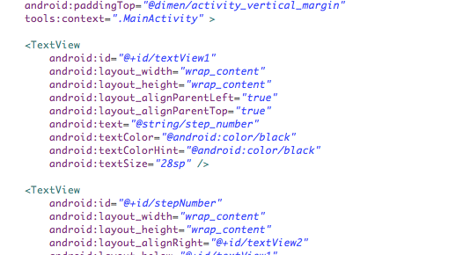
Android & MDE

Slide 5

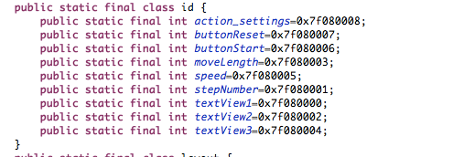
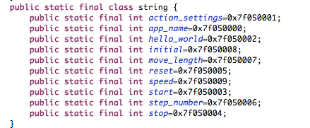
Android & MDE
The layout designer on Android platform can generate UI to xml code.
The ADT transform the xml code to java code to implement the Android application.

Slide 6
Procedure
Step Count
Step Detect
Move
Length
Step Length
Walk Speed
Walk Time

Slide 7
Step Detect
Using accelerate sensor in mobile
Collect Data
Data handling
Remove gravity contribution with high-pass filter.
Isolate the force of gravity with low-pass filter.
Eliminate the noise signal.
Norm the three axis.
Through the low-pass filter.
Augment the signal by square the data.
Integrate the data.
Detect Step
Find the peak in time interval
Check the peak value by threshold.
Add one found step.

Slide 8
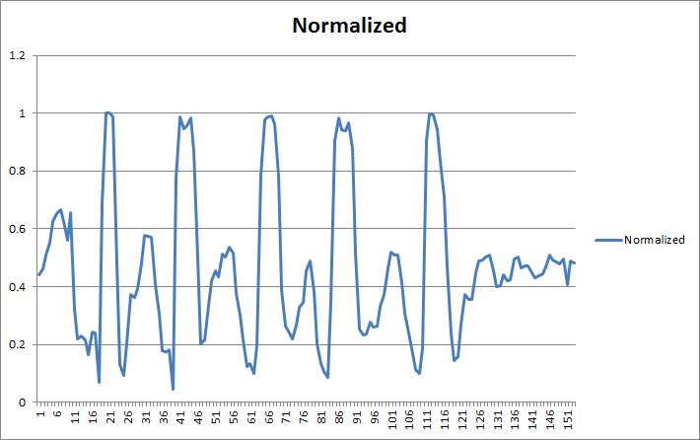
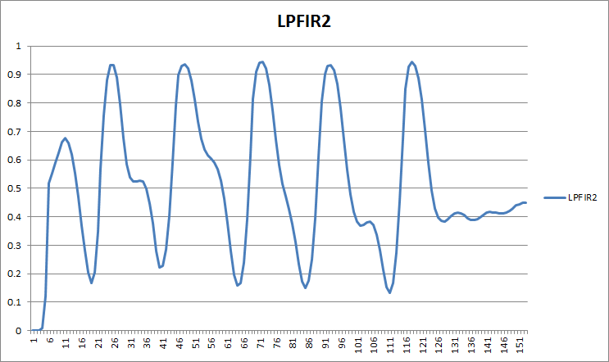
Data processing

Slide 9
Step Length
Using accelerate sensor in mobile
Collect Data
Data handling
Remove gravity contribution with high-pass filter.
Isolate the force of gravity with low-pass filter.
Norm the three axis.
Through the low pass filter.
Store the data into an array.
Calculate
Find the max and min value in the array.
Calculate every step length.

Slide 10
Timer and Speed
When press Start button, a timer runs in the background to count the time the user have waked.
Every step the user take, the system will calculate the total move length of the user.
So, it is easy to get the average walk speed by

Slide 11
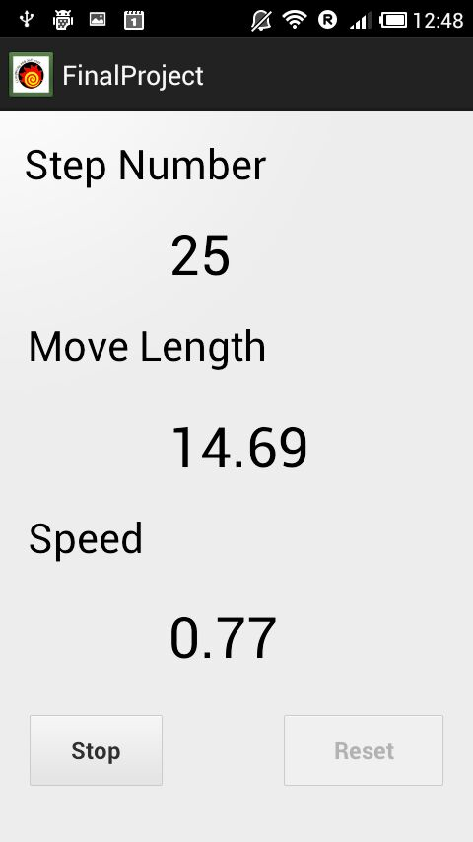
Demo

Slide 12
Q&A
Thanks

